Slide 1
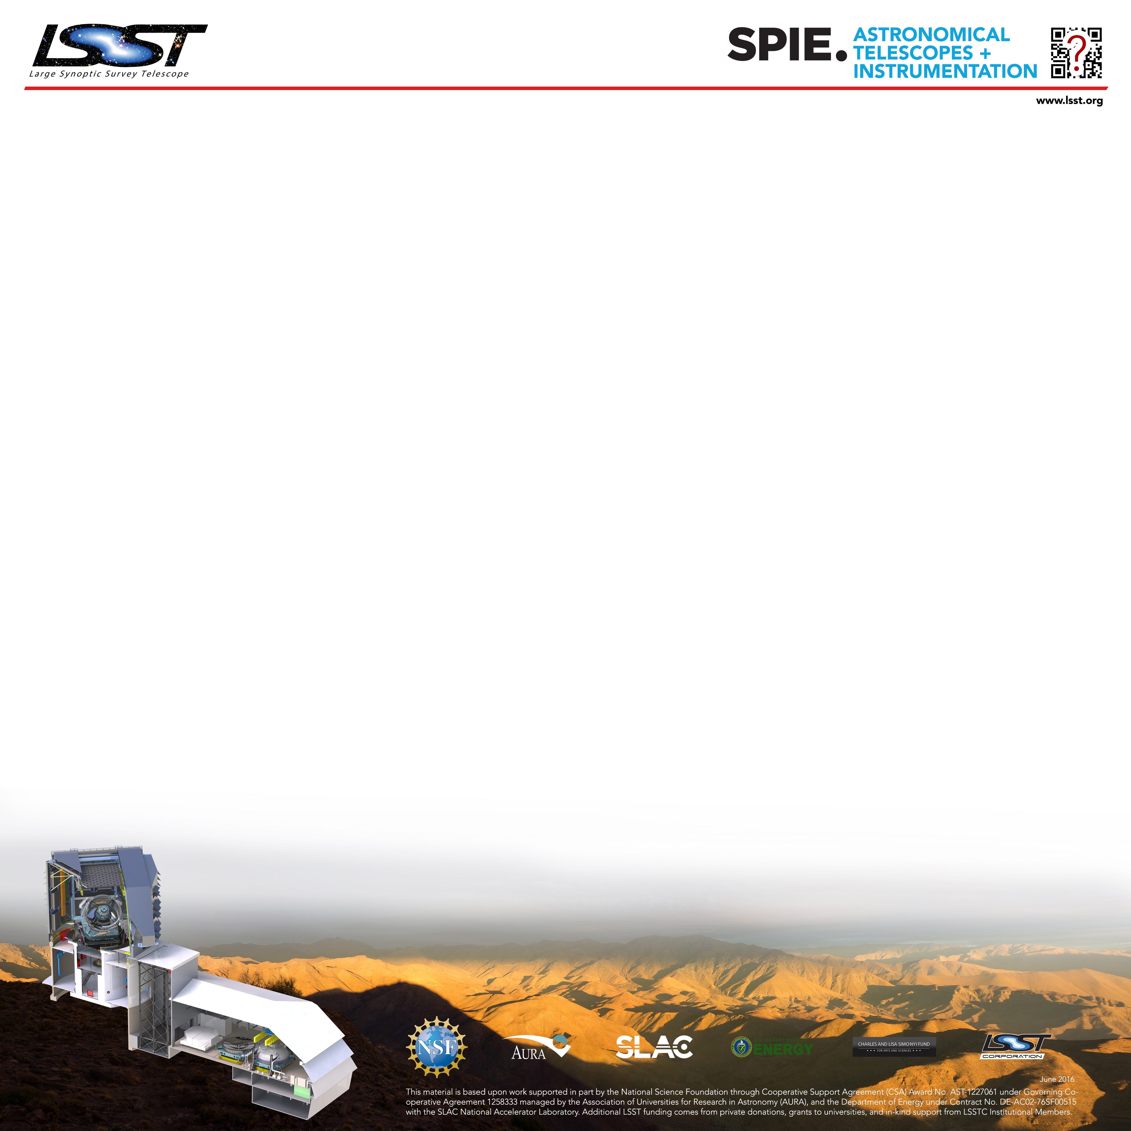
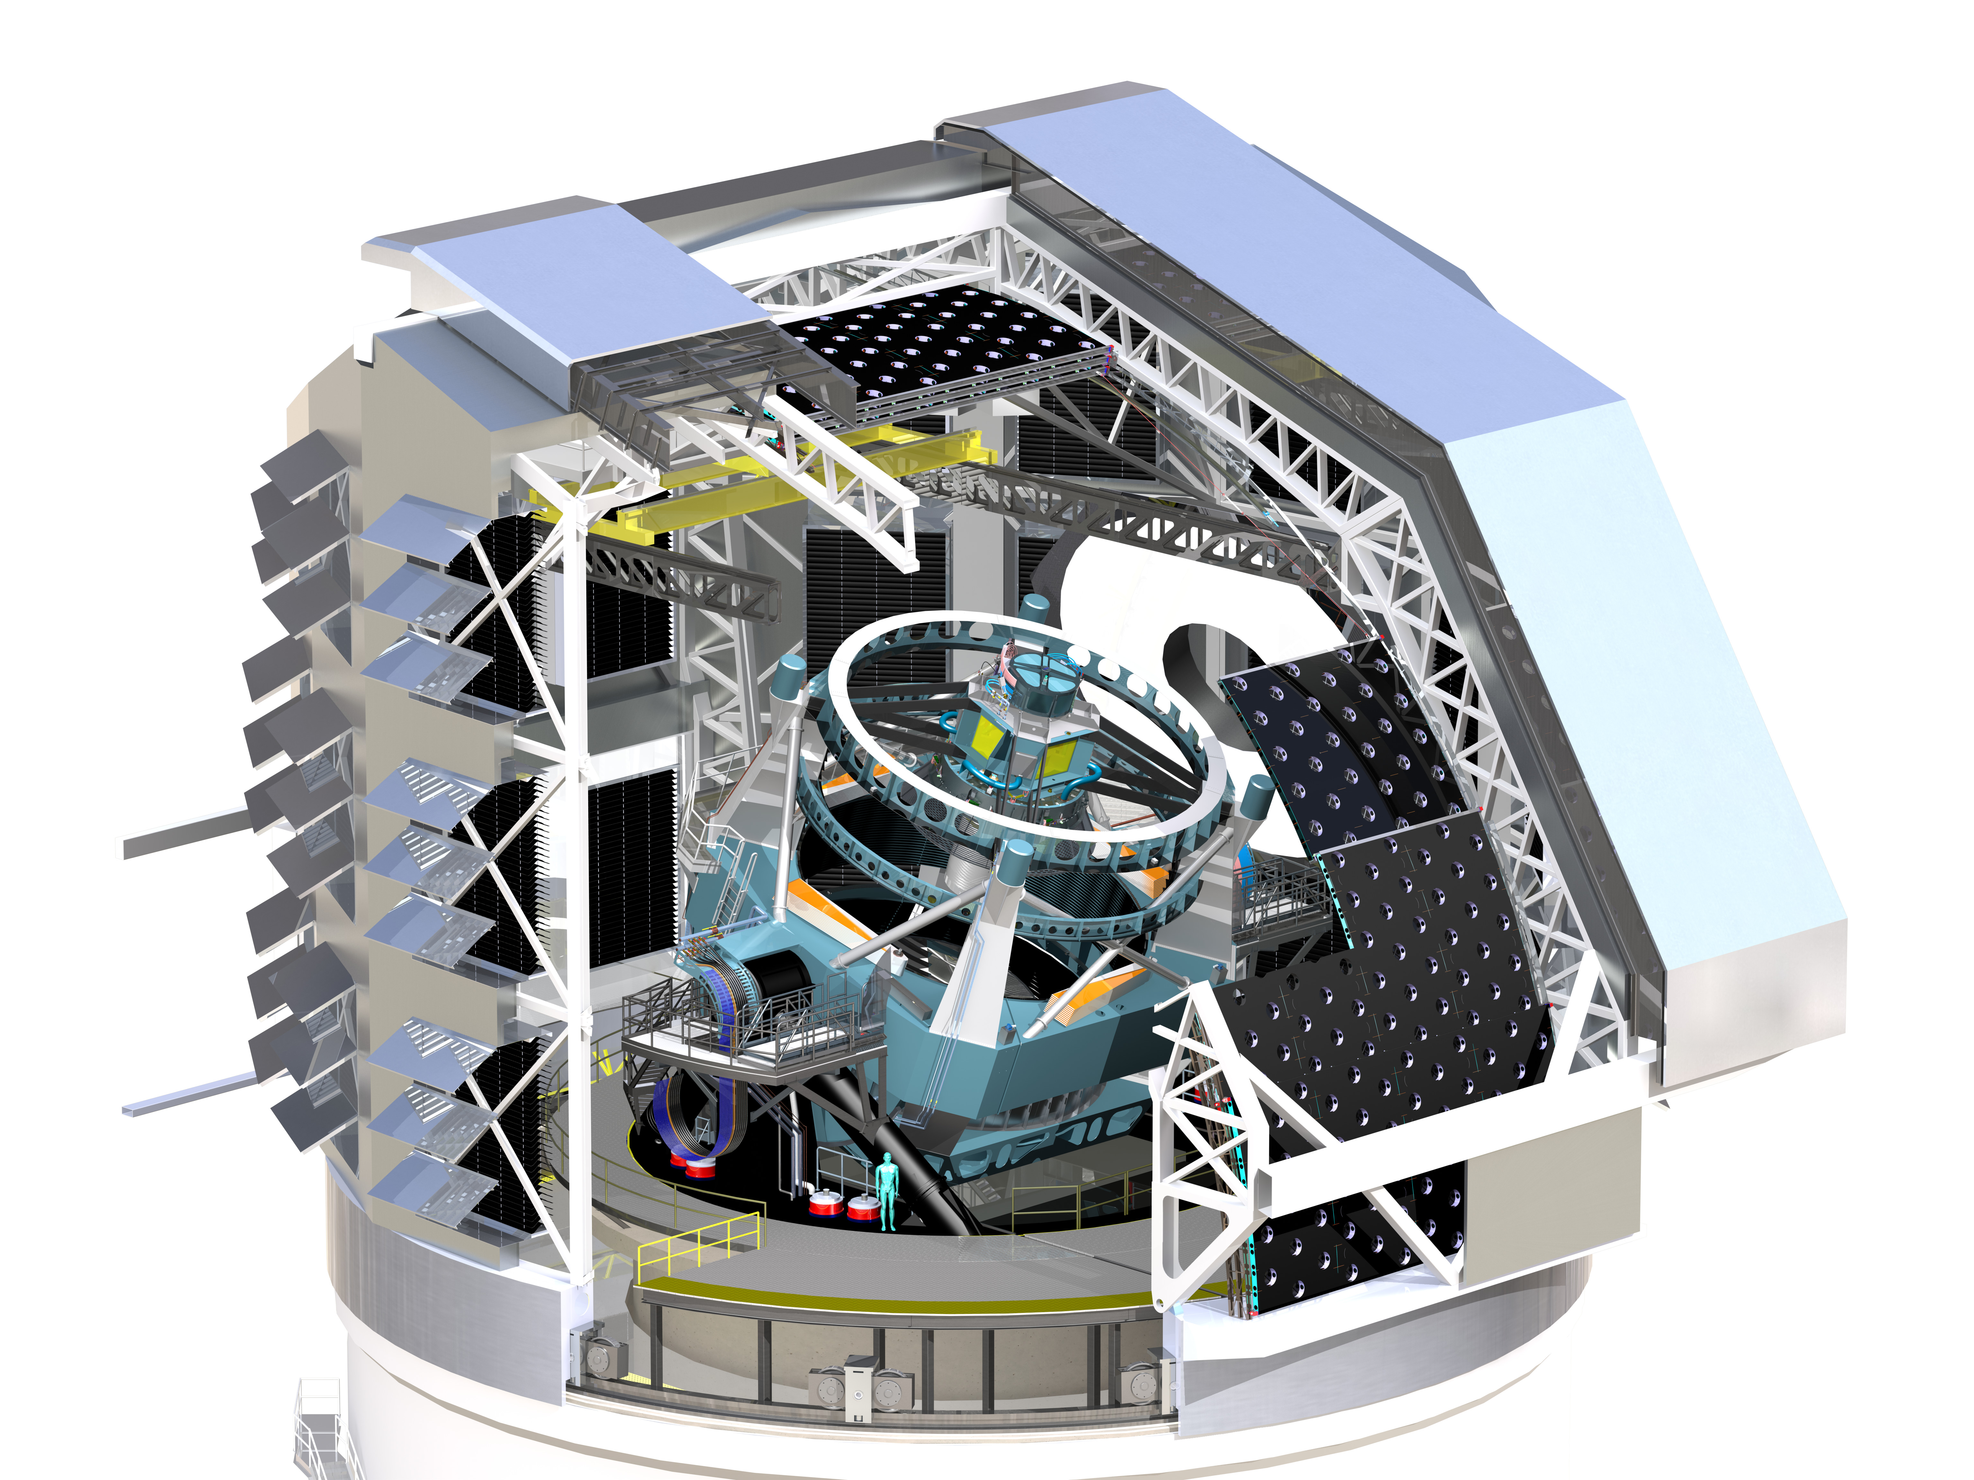
Simulating the LSST OCS for Conduction Survey Simulations Using the LSST Scheduler Michael A. Reuterª, Kem H. Cook^{b}, Francisco Delgadoª, Catherine E. Petryª, Stephen T. Ridgway^{c}
ªLarge Synoptic Survey Telescope ^{b}Cook Astronomical Consulting ^{c}National Optical Astronomy Observatory
INTRODUCTION
DEVELOPMENT
USE CASES
The Operations Simulator (OpSim3)¹ was used to prototype the LSST Scheduler. Currently the Scheduler² is being developed separately to interface with the LSST Observatory Control System (OCS)^{3,4}. A new Simulator is under concurrent development to adjust to this new architecture. This requires a package simulating enough of the OCS to allow execution of realistic schedules. This new package is called the Simulated OCS (SOCS). The new SOCS/Scheduler pair is collectively called OpSim4.
Scheduler
Separated SOCS/Scheduler allows for interesting use cases:
SOCS
Simulation
Kernel
Control
SOCS
Sequencer
EFD
Configuration and visit
history for SOCS taken
from Engineering Facilities DB (EFD) to create clone of operational Scheduler
History
OCS
Telemetry
Cmd
Visits
Image Quality
Sched
Telem
Operations
Scheduler
Targets
Visits
SOCS
Proposed
Fields
communications middleware
Run forward for
schedule time window
SOCS
Survey Database
SOCS
Observatory
Model
SOCS
Quality
Simulator
SOCS
Environment
Model
Scheduler
Figure 3: Using clone of operational Scheduler to forecast the proposed target fields for a given time window (e.g. 2 hours).
Figure 2: Diagram showing the communication pathways between SOCS and the Scheduler systems.
EFD
Configuration and visit
history for SOCS taken
from Engineering Facilities DB (EFD) to create clone of operational Scheduler
Operations Simulator
Scheduler
Operations Simulator
Simulated OCS (SOCS)
Scheduler
DDS
The current development plan has version 1.0 of OpSim4 slated for delivery in the fall of 2016. It will replace all of the functionality of OpSim3 plus some enhancements not available in OpSim3.
OCS
Operations
Scheduler
Alternate
Configuration
SOCS
Survey
DB
Figure 1a: Operational bounding box for OpSim version 3 (OpSim3). Scheduler prototype is embedded within simulator.
Figure 1b: Operational bounding box for OpSim version 4 (OpSim4). Scheduler is separated from simulator and communicates across common API (DDS*)
SOCS software development uses the LSST Agile process⁵ and follows the basic tenants of Test Driven Design (TDD)⁶. Each release cycle is tightly coupled with the LSST Scheduler development cycle. Integration of new features occurs continuously throughout the release cycle.
Add/change science proposals and configuration to produce “new” survey
Scheduler
Figure 4: Using clone of operational Scheduler to explore new or varied science proposals and instrument configurations.
*DDS is the Data Distribution Service. See reference [4].
REFERENCES
Cook, K. et. al., Proc SPIE 9911 in press (2016)
Delgado, F., Proc SPIE 9910 in press (2016)
Daly, P. and Schumacher, H., Proc SPIE 9913 in press (2016)
Mills, D. et. al., Proc SPIE 9906 in press (2016)
Kantor, J. et. Al., Proc SPIE 9911 in press (2016)
Beck, K., Test Driven Development: By Example (2002)

